Slide 1
X-ray Photoelectron Spectroscopy
——Application in Phase-switching Device Study
Xinyuan Wang
A53073806

Slide 2
Outline
Background
Basic Principles
XPS Instruments
Data Analysis
Application in Reference Paper

Slide 3

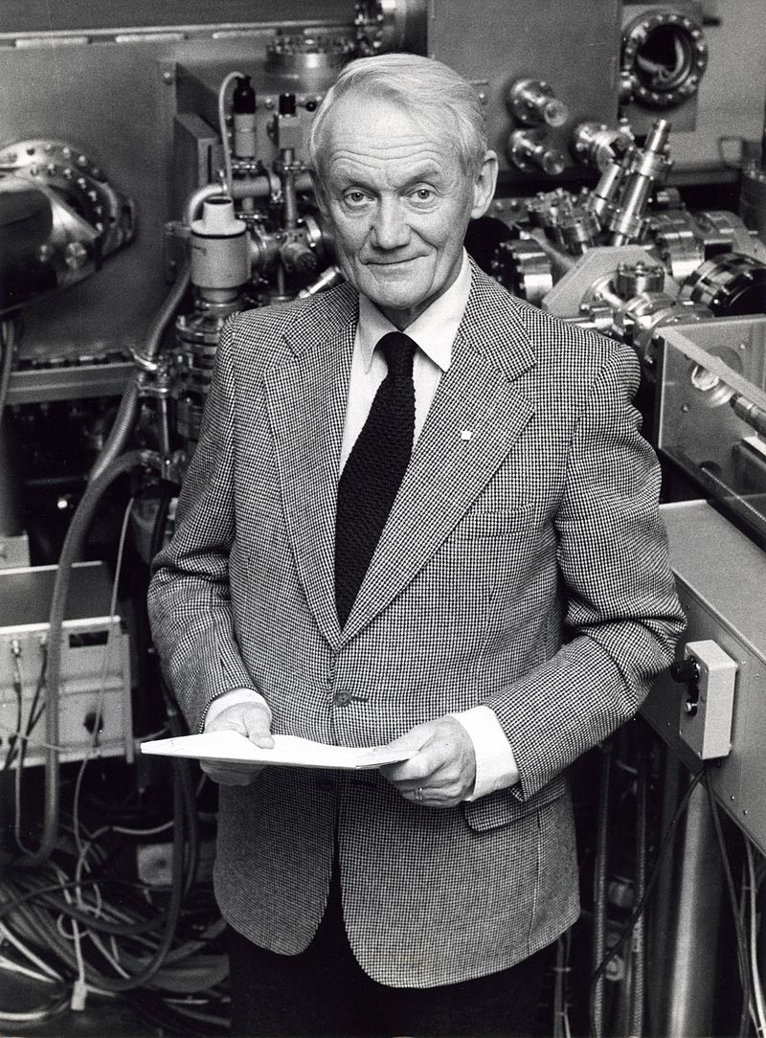
Background
XPS, based on photoelectric effect, was first explained by Albert Einstein
During the mid 1960’s Dr. Siegbahn and his research group developed the XPS technique

Slide 4
Outline
Background
Basic Principles
XPS Instruments
Data Analysis
Application in Reference Paper

Slide 5
Basic Principles
X-rays
  Irradiate the sample surface, hitting the core electrons (e⁻) of the atoms
  Penetrate the sample to a depth on the order of a micrometer
  Useful emission electron signal is obtained only from a depth of around 10 to 100 Å on the surface
  The X-Ray source produces photons with either certain energies, known as monoenergetic X-ray beam
    MgKα photon with an energy of 1253.6 eV
    AlKα photon with an energy of 1486.6 eV

Slide 6
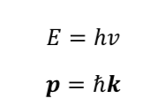

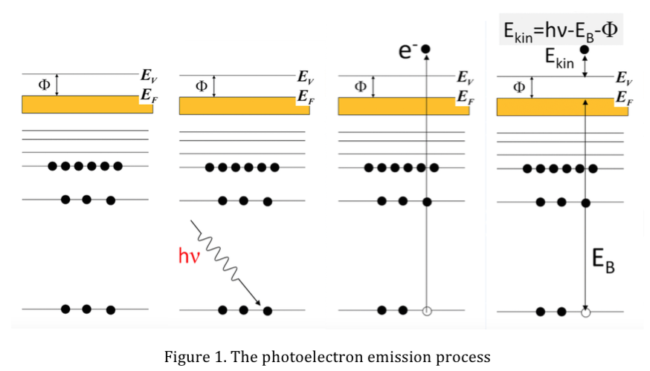
Basic Principles
electron emission when transfer energy is greater than the electron’s binding energy
Photon

Slide 7
Outline
Background
Basic Principles
XPS Instruments
Data Analysis
Application in Reference Paper

Slide 8
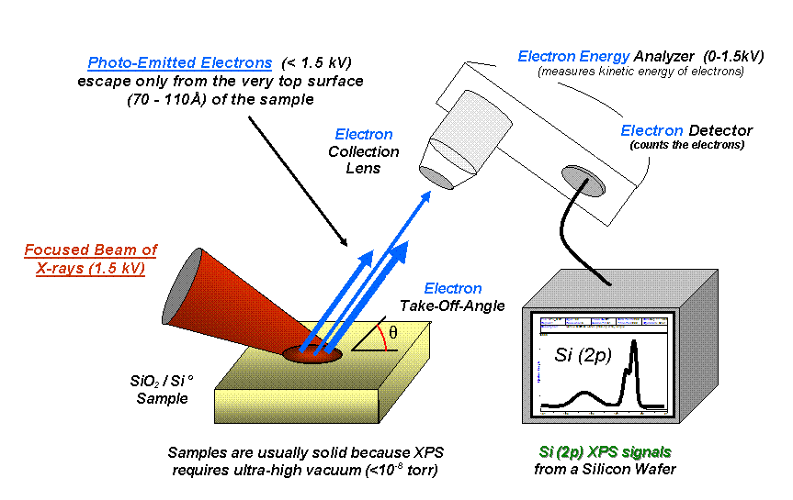
Instrument
The technique is widely used because it is very simple to use and the data is easily analyzed
Commonly the system has three main modules
  An X-ray source
  An electron energy analyzer
  A detection system

Slide 9
Instrument
Ultra High Vacuum (UHV) environment
  all the three modules are contained in a vacuum chamber
  Signal of emitted electrons will decrease with residual gas molecules
  Surface sensitivity of XPS
The Sample
  be stable in a vacuum chamber
  sample size amenable to the instrument
  surface of sample remains clean before and during analysis
X-ray Sources
  high energy anode materials with small line width
  provide depth profiling capability

Slide 10
Outline
Background
Basic Principles
XPS Instruments
Data Analysis
Application in Reference Paper

Slide 11
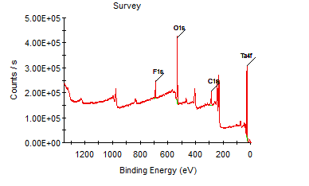
Data Analysis
XPS Survey Spectrum
  a wide scan over a region that provide strong peaks for all elements
  identify elements present
    XPS peaks are sharp
    large C 1s resulting from the deposition of adventitious carbon from the atmosphere

Slide 12
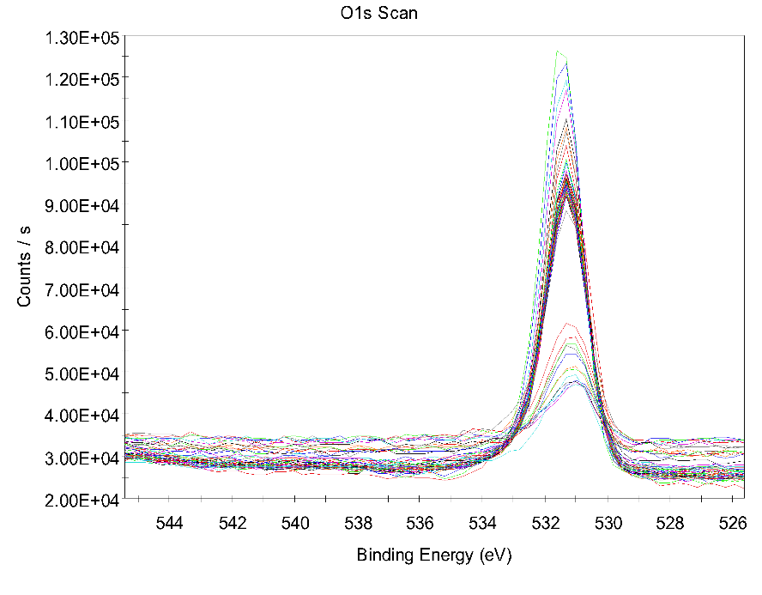
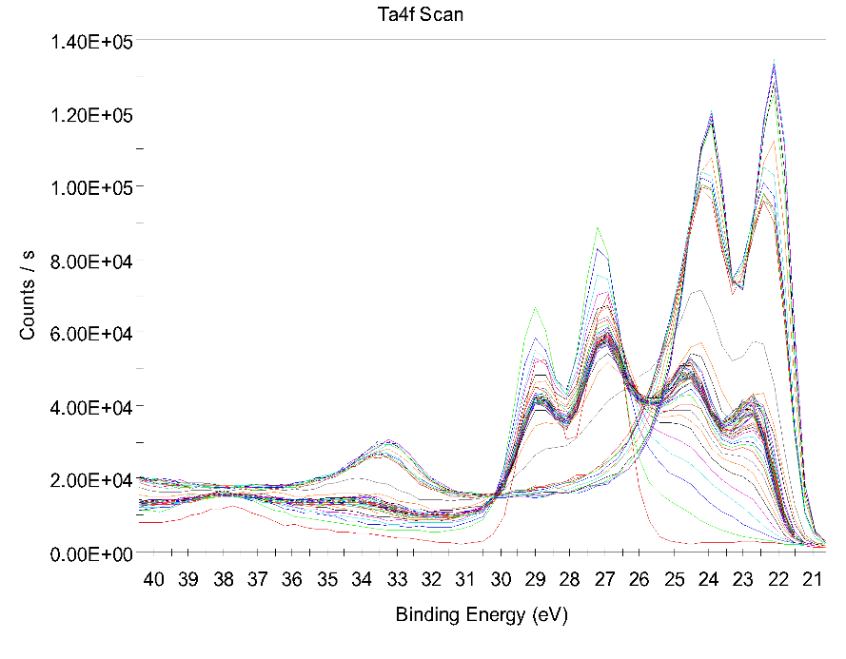
Data Analysis
Followed up by spectra around the elemental peaks of interest
Depth Profiling
  etch and analyze

Slide 13
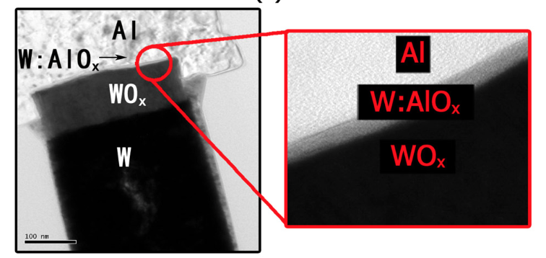
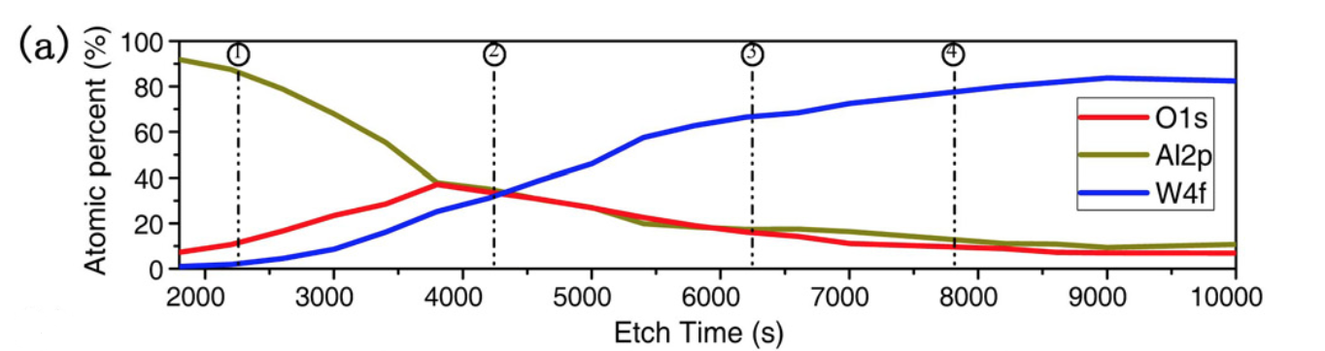
Data Analysis
Depth Profiling
  concentration of different elements versus depth within 10nm
Application in Reference paper

Slide 14
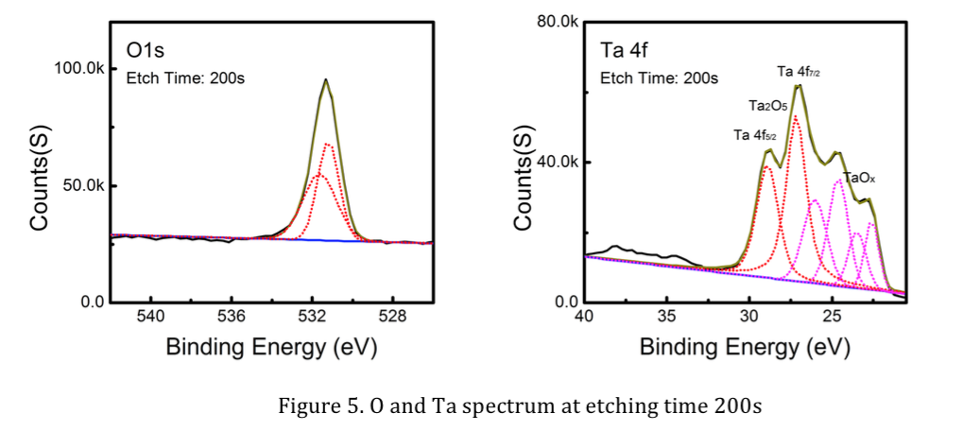
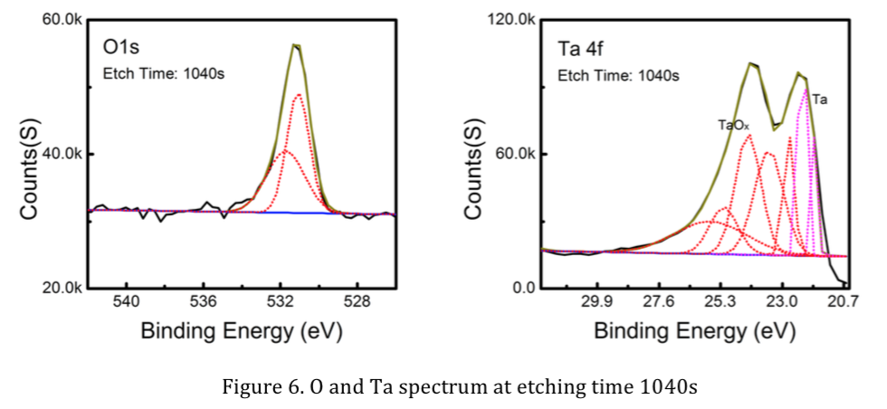
Data Analysis
Chemical Shift
  small changes in electron energy regarding to chemical environment of the emitting element
  computer curve fitting of high-resolution XPS spectra

Slide 15
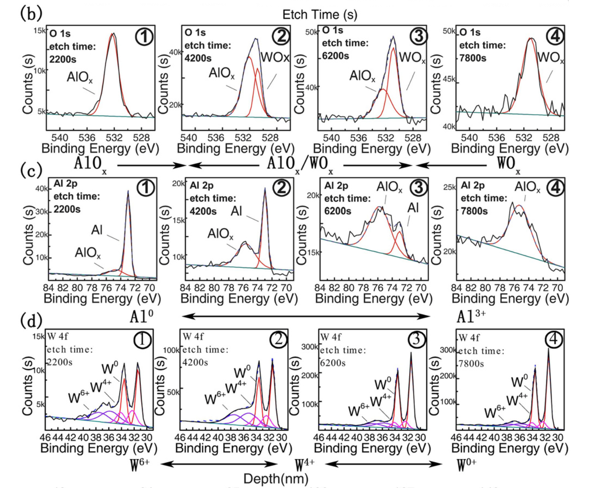
Data Analysis
Similar process in reference paper

Slide 16
Thank you!

